Slide 1
Life Expectancy Submitted By E R Shyama

Slide 2
Problem description & Approach Used
Life expectancy is a statistical measure of the estimate of the span of a life.
The objective of the problem is statistical analysis on factors influencing life expectancy.
The given dataset contains various features related to lifestyle, health expenditure, immunization , demography and mortality.
Target feature(Life Expectancy) is continuous in nature and so this is a regression problem.
There are 21 features and 2938 data instances in the initial dataset.
Following operations are performed on the dataset prior to conclusion of results – data clean up, outlier treatment, one hot encoding on specific features, plotting correlation matrix, scatter plot, fitted model using linear regression and analysed the results.

Slide 3
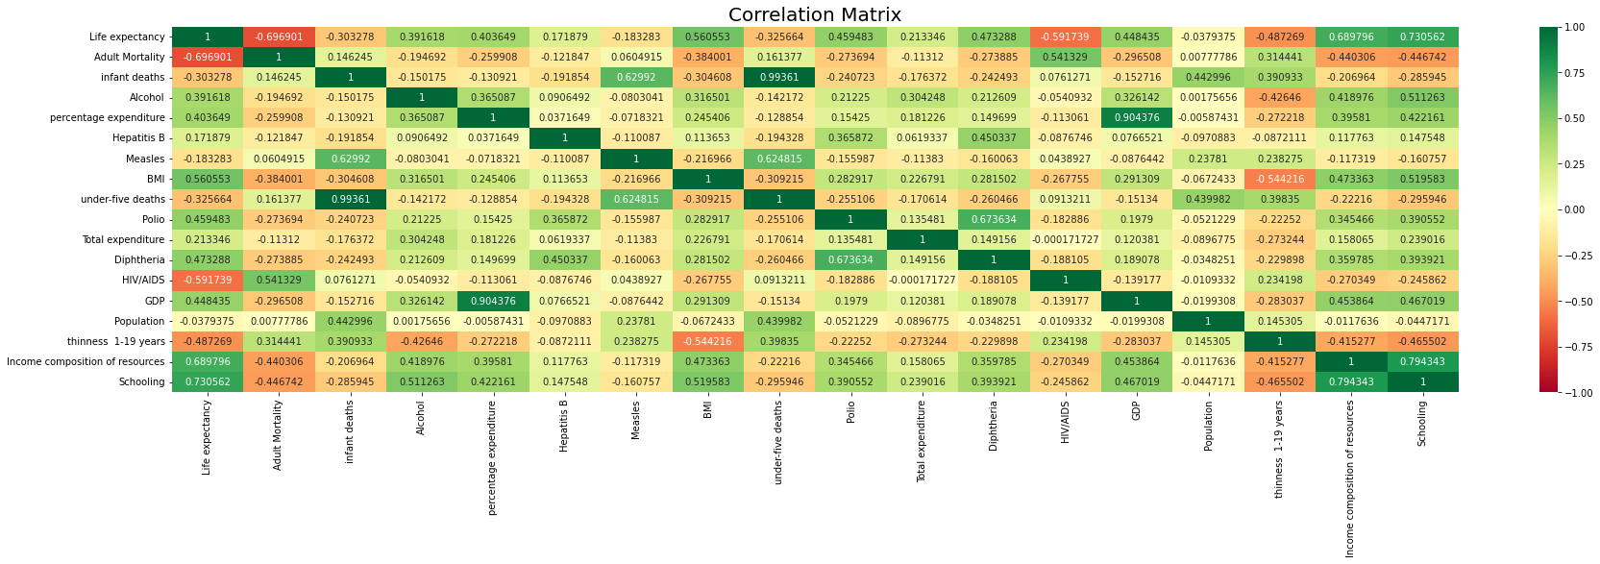
Correlation Matrix

Slide 4
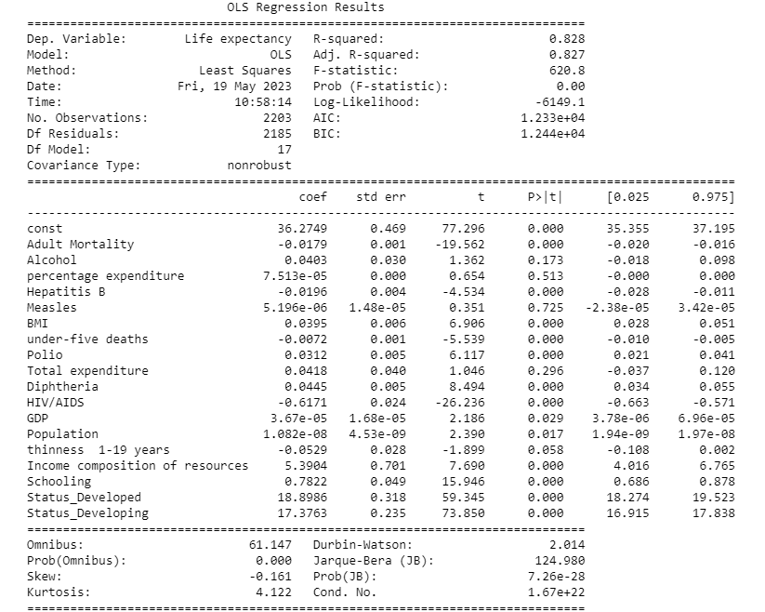
Linear Regression Summary

Slide 5
Question & Answers
1. Does various predicting factors which has been chosen initially really affect Life expectancy? What are the predicting variables actually affecting life expectancy?
Ans: No. The predicting variables affecting Life Expectancy are Status, Adult Mortality, Hepatitis B, under-five deaths, Polio, Diphtheria, HIV/AIDS, Income composition of resources and Schooling.
2. Should a country having a lower life expectancy value(<65) increase its healthcare expenditure in order to improve its average lifespan?
Ans: No. Healthcare expenditure has no relation with life expectancy value.
3. How do Infant and Adult mortality rates affect life expectancy?
Ans: ‘Infant deaths’ column has been removed as it highly correlated(99%) with ‘under-five deaths’ column. Life expectancy is inversely proportional to adult mortality and under-five deaths. Life expectancy increases by 1 as adult mortality decreases by 0.0179 times and under-five deaths decreases by 0.0072 times.
4. Does Life Expectancy has a positive or negative correlation with eating habits, lifestyle, exercise, smoking, drinking alcohol etc?
Ans: Life expectancy has a positive correlation with drinking alcohol(0.39) and BMI(0.56). Life expectancy also has positive correlation with percentage expenditure(0.40) which is expenditure on health as a percentage of GDP per capita.

Slide 6
Question & Answers
5. What is the impact of schooling on the lifespan of humans?
Ans: Schooling has a positive impact on life expectancy. Value of probability(T) for Schooling is 0.00 indicates its impact on Life expectancy.
Life expectancy increases by 1 as schooling increases 0.78 times.
6. Does Life Expectancy have a positive or negative relationship with drinking alcohol?
Ans: Life expectancy has positive relationship with drinking alcohol. Life expectancy increases by 1 as drinking alcohol increases 0.0403 times.
7. Do densely populated countries tend to have lower life expectancy?
Ans: No. Population does not have any impact on Life expectancy.
8. What is the impact of Immunization coverage on Life Expectancy?
Ans: Hepatitis B immunization has negative impact on life expectancy
Polio immunization and Diphtheria immunization has positive impact on life expectancy.
Value of probability(T) for Hepatitis B, Polio and Diphtheria is 0.00 indicates its impact on Life expectancy.
Life expectancy increases by 1 as Hepatitis B immunization decreases 0.0196 times.
Life expectancy increases by 1 as Polio immunization and Diphtheria immunization increases 0.0312 times and 0.0445 times.

